Slide 1
Factorization Machines (FM) and Field-aware Factorization Machines (FFM)
Hung-Hsuan Chen
https://www.ncu.edu.tw/~hhchen/

Slide 2
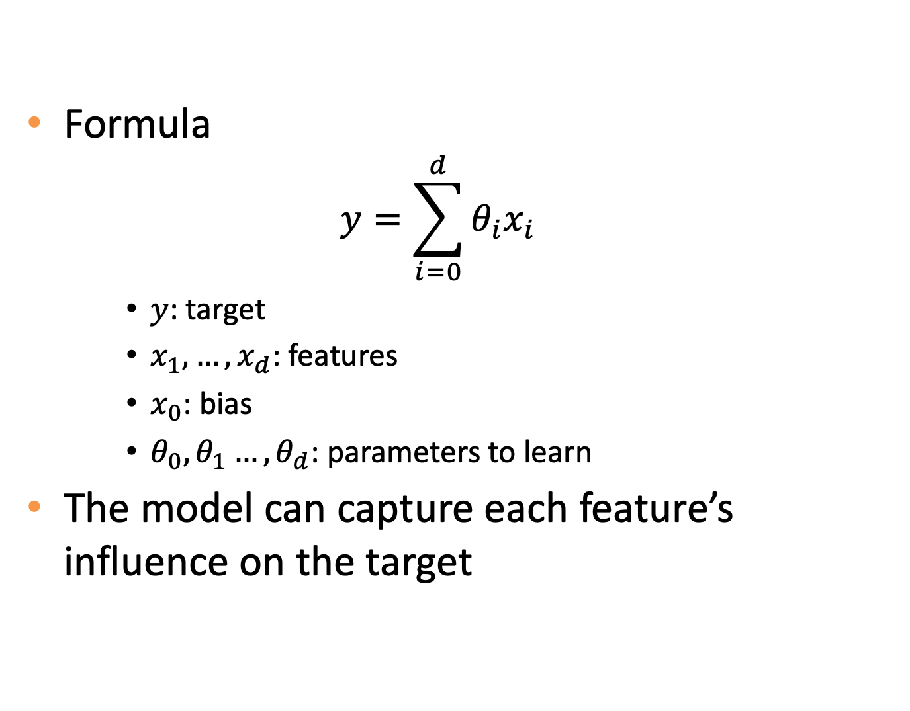
Linear model
Formula
$$y=\sum_{i=0}^{d}{θ_{i}x_{i}}$$
$y$: target
$x_{1},…,x_{d}$: features
$x_{0}$: bias
$θ_{0}, θ_{1}…, θ_{d}$: parameters to learn
The model can capture each feature’s influence on the target

Slide 3
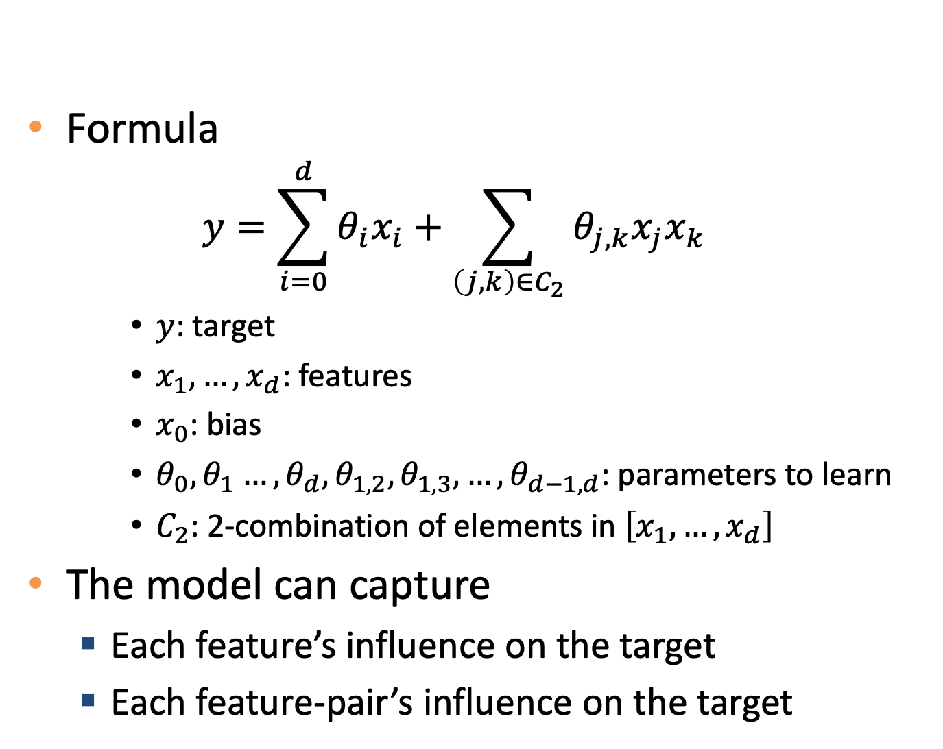
Degree-2 polynomial model (poly2)
Formula
$$y=\sum_{i=0}^{d}{θ_{i}x_{i}}+\sum_{\left(j,k\right)∈C_{2}}{θ_{j,k}x_{j}x_{k}}$$
$y$: target
$x_{1},…,x_{d}$: features
$x_{0}$: bias
$θ_{0}, θ_{1}…, θ_{d},θ_{1,2},θ_{1,3},…,θ_{d−1,d}$: parameters to learn
$C_{2}$: 2-combination of elements in $\left[x_{1},…,x_{d}\right]$
The model can capture
Each feature’s influence on the target
Each feature-pair’s influence on the target

Slide 4
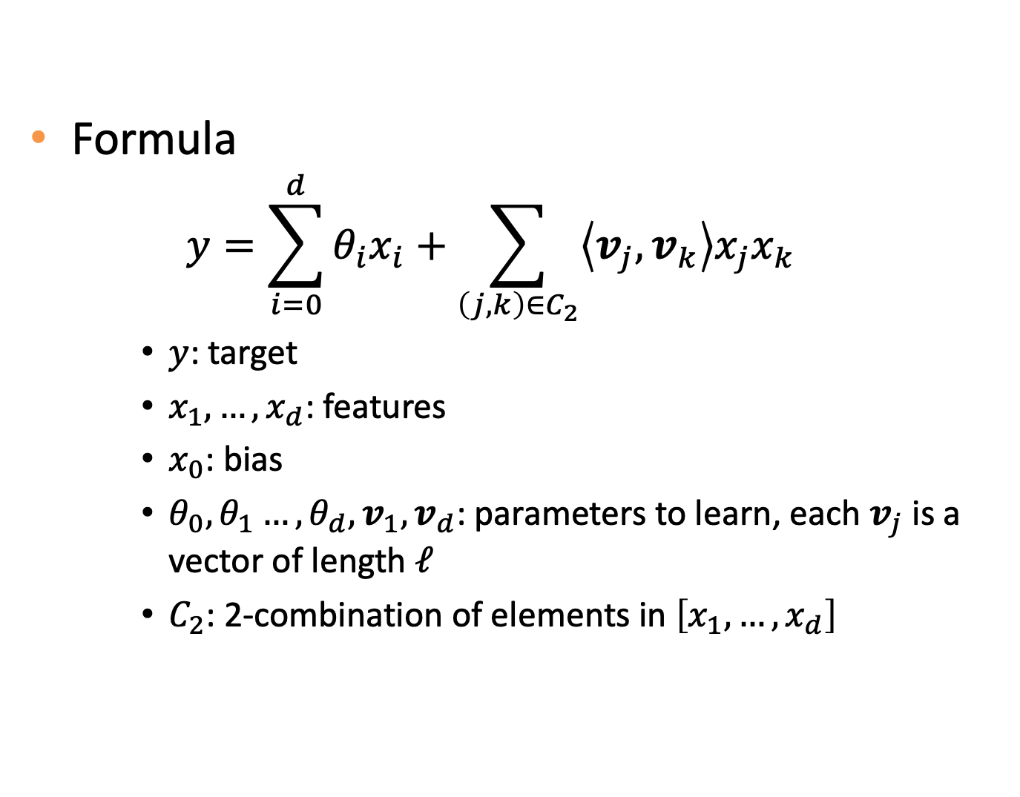
Factorization machines (FM)
Formula
$$y=\sum_{i=0}^{d}{θ_{i}x_{i}}+\sum_{\left(j,k\right)∈C_{2}}{\left\langle v_{j},v_{k}\right\rangle x_{j}x_{k}}$$
$y$: target
$x_{1},…,x_{d}$: features
$x_{0}$: bias
$θ_{0}, θ_{1}…, θ_{d},v_{1}, v_{d}$: parameters to learn, each $v_{j}$ is a vector of length $ℓ$
$C_{2}$: 2-combination of elements in $\left[x_{1},…,x_{d}\right]$

Slide 5
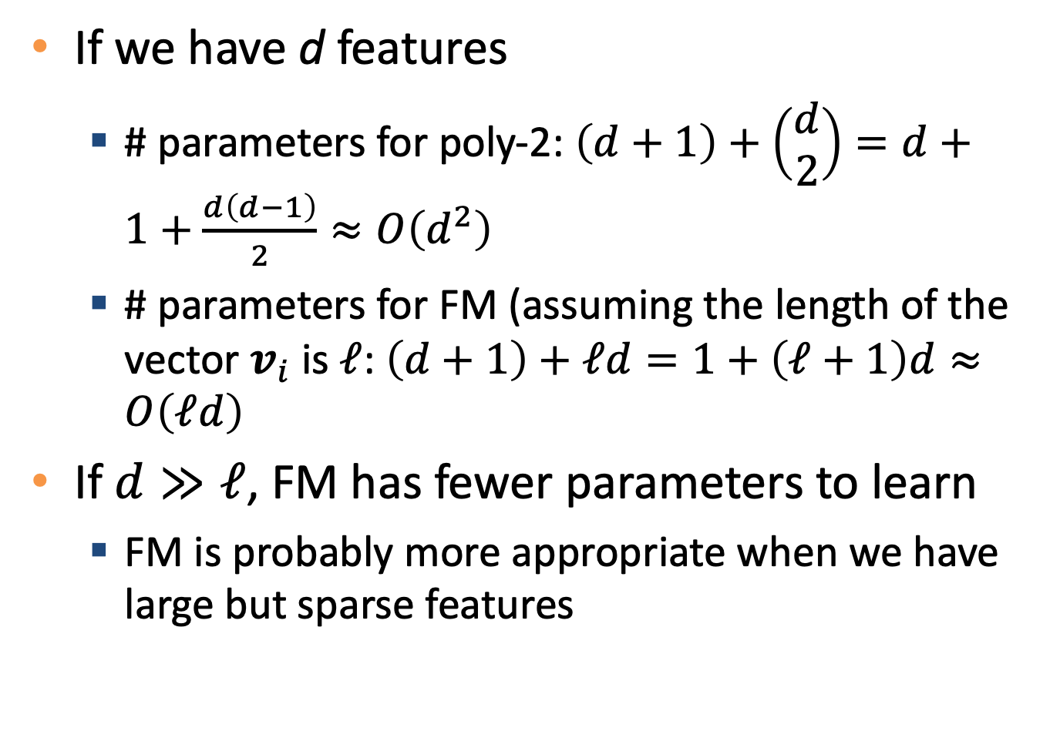
Poly2 vs FM (# parameters)
If we have d features
# parameters for poly-2: $\left(d+1\right)+\left(\begin{matrix}d \\ 2\end{matrix}\right)=d+1+\frac{d\left(d−1\right)}{2}≈O\left(d^{2}\right)$
# parameters for FM (assuming the length of the vector $v_{i}$ is $ℓ$: $\left(d+1\right)+ℓd=1+\left(ℓ+1\right)d≈O\left(ℓd\right)$
If $d≫ℓ$, FM has fewer parameters to learn
FM is probably more appropriate when we have large but sparse features

Slide 6
Example: ad classification
Country | Day | Ad type | Clicked?
USA | Thanksgiving | Movie | 1
China | Chinese New Year | Game | 0
China | Thanksgiving | Game | 1
Task: given features, predict click or not
Example take from: https://www.slideshare.net/EvgeniyMarinov/factorization-machines-and-applications-in-recommender-systems

Slide 7
Example: ad classification (cont’)
Standard one-hot encoding
Very large feature space
Very sparse samples
USA | China | Thanksgiving | Chinees new year | Movie | Game | Clicked?
1 | 0 | 1 | 0 | 1 | 0 | 1
0 | 1 | 0 | 1 | 0 | 1 | 0
0 | 1 | 1 | 0 | 0 | 1 | 1

Slide 8
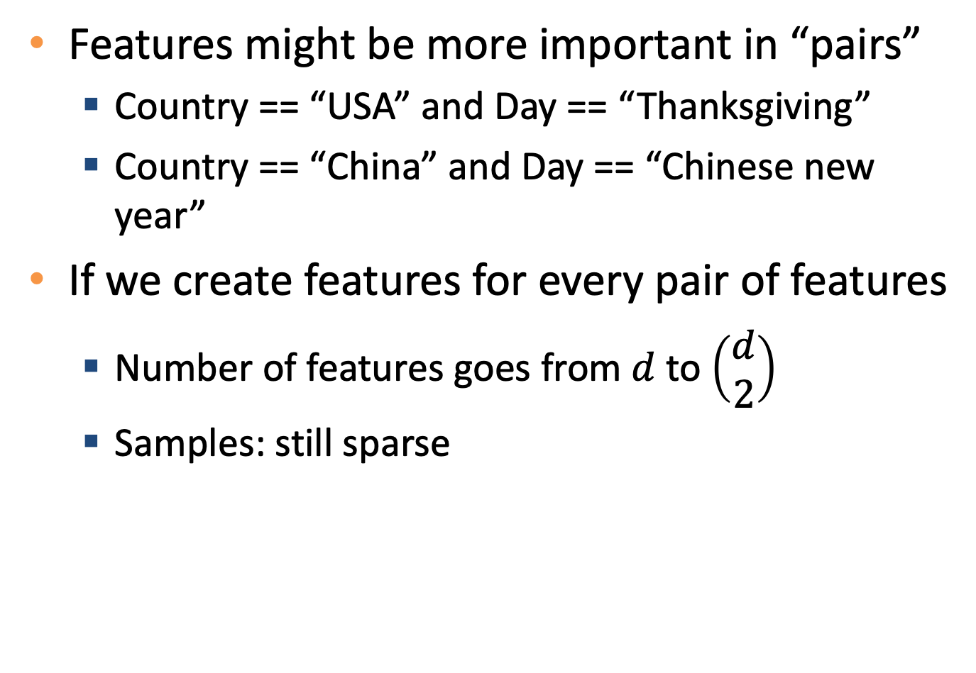
Example: ad classification (cont’)
Features might be more important in “pairs”
Country == “USA” and Day == “Thanksgiving”
Country == “China” and Day == “Chinese new year”
If we create features for every pair of features
Number of features goes from $d$ to $\left(\begin{matrix}d \\ 2\end{matrix}\right)$
Samples: still sparse

Slide 9
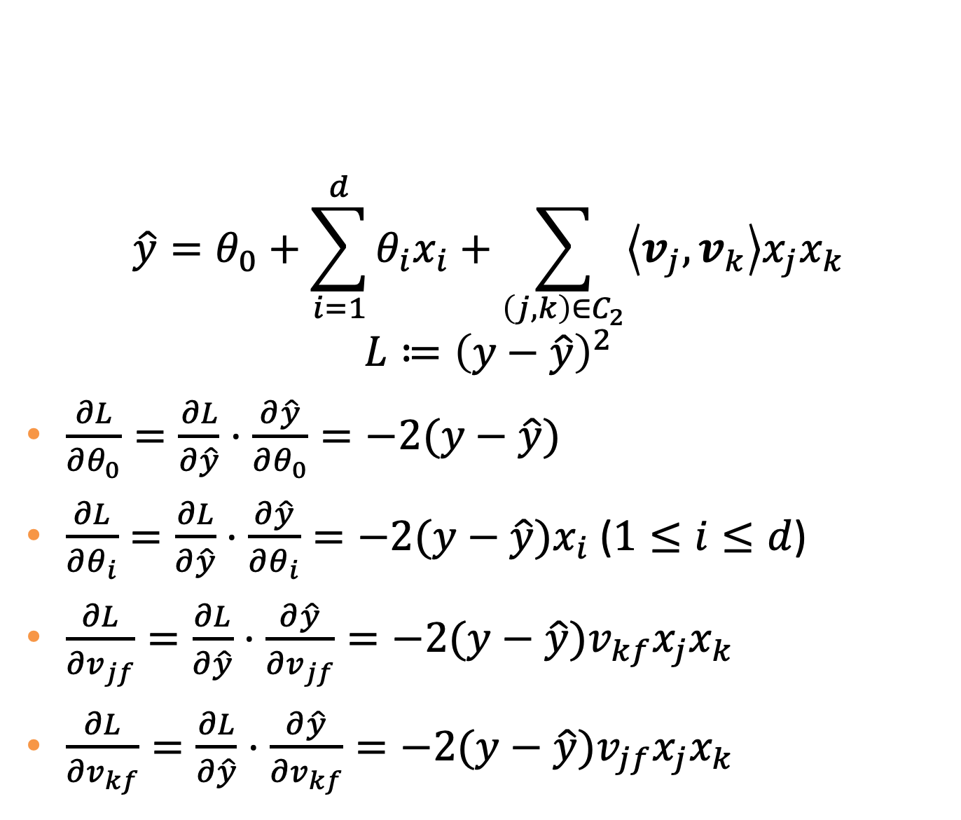
Gradients
$$\hat{y}=θ_{0}+\sum_{i=1}^{d}{θ_{i}x_{i}}+\sum_{\left(j,k\right)∈C_{2}}{\left\langle v_{j},v_{k}\right\rangle x_{j}x_{k}}$$
$$L≔{\left(y−\hat{y}\right)}^{2}$$
$\frac{∂L}{∂θ_{0}}=\frac{∂L}{∂\hat{y}}⋅\frac{∂\hat{y}}{∂θ_{0}}=−2(y−\hat{y})$
$\frac{∂L}{∂θ_{i}}=\frac{∂L}{∂\hat{y}}⋅\frac{∂\hat{y}}{∂θ_{i}}=−2(y−\hat{y})x_{i}$ ($1≤i≤d$)
$\frac{∂L}{∂v_{jf}}=\frac{∂L}{∂\hat{y}}⋅\frac{∂\hat{y}}{∂v_{jf}}=−2(y−\hat{y})v_{kf}x_{j}x_{k}$
$\frac{∂L}{∂v_{kf}}=\frac{∂L}{∂\hat{y}}⋅\frac{∂\hat{y}}{∂v_{kf}}=−2(y−\hat{y})v_{jf}x_{j}x_{k}$

Slide 10
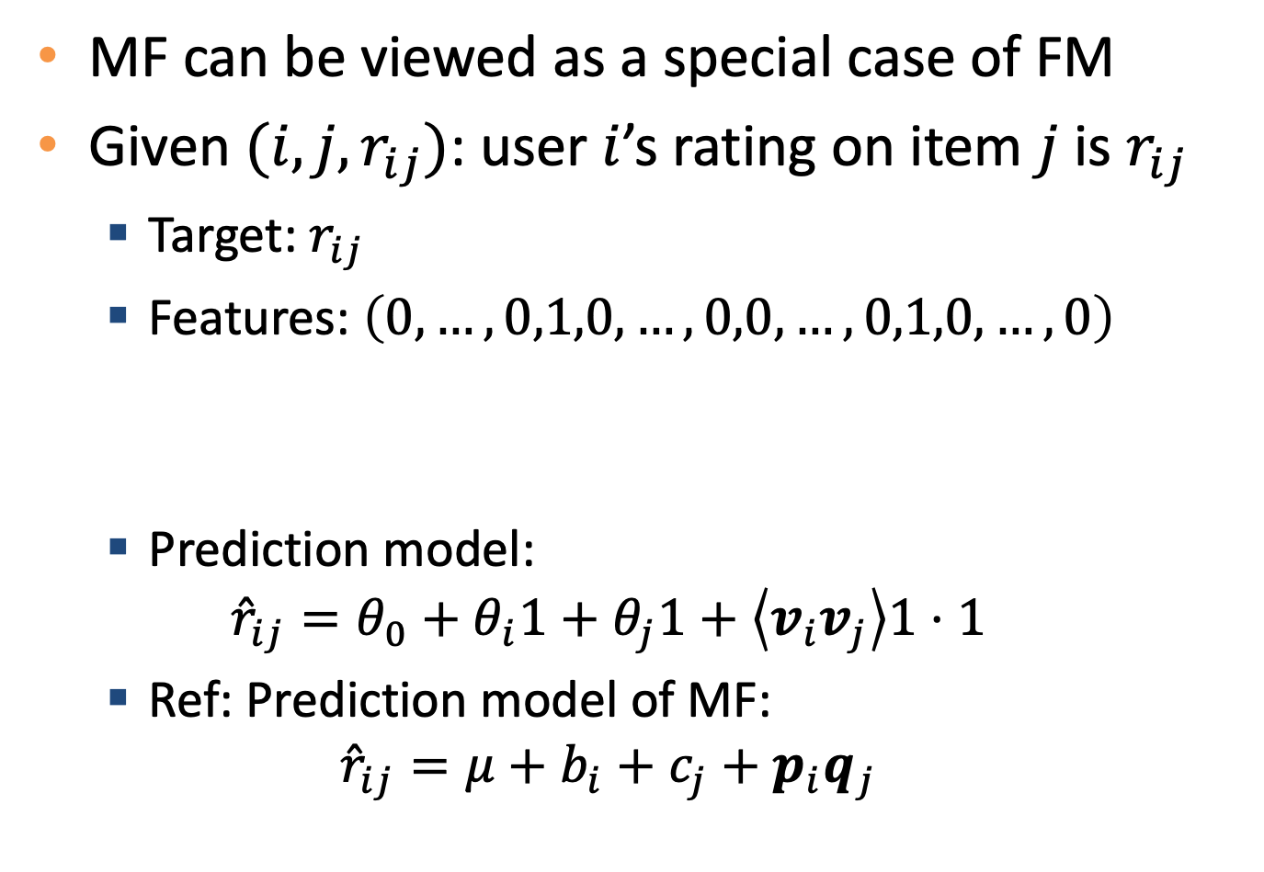
FM vs MF
MF can be viewed as a special case of FM
Given $(i,j,r_{ij})$: user $i$’s rating on item $j$ is $r_{ij}$
Target: $r_{ij}$
Features: $\left(0,…,0,1,0,…,0,0,…,0,1,0,…,0\right)$
Prediction model:
$${\hat{r}}_{ij}=θ_{0}+θ_{i}1+θ_{j}1+\left\langle v_{i}v_{j}\right\rangle 1⋅1$$
Ref: Prediction model of MF:
$${\hat{r}}_{ij}=μ+b_{i}+c_{j}+p_{i}q_{j}$$
$$|U|$$
$$|I|$$

Slide 11
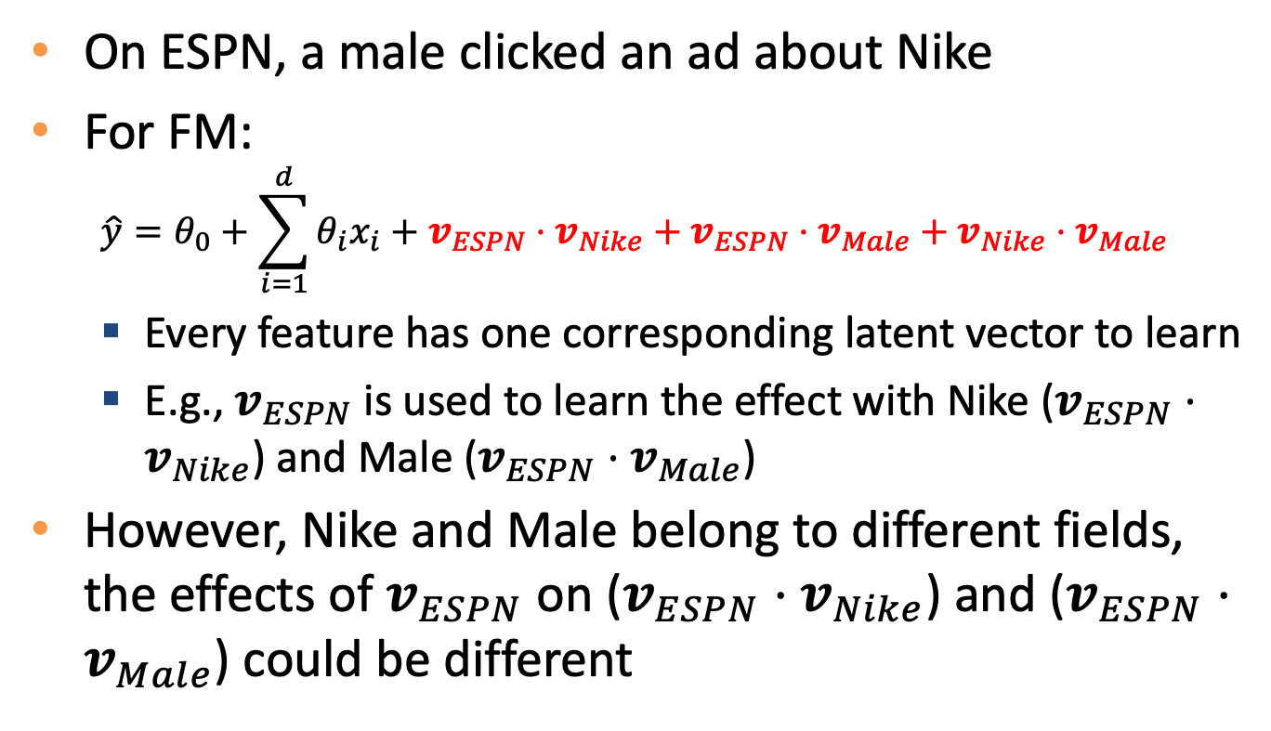
FFM example
Publisher (P) | Advertiser (A) | Gender (G) | Clicked?
ESPN | Nike | Male | Yes
On ESPN, a male clicked an ad about Nike
For FM:
$$\hat{y}=θ_{0}+\sum_{i=1}^{d}{θ_{i}x_{i}}+v_{ESPN}⋅v_{Nike}+v_{ESPN}⋅v_{Male}+v_{Nike}⋅v_{Male}$$
Every feature has one corresponding latent vector to learn
E.g., $v_{ESPN}$ is used to learn the effect with Nike ($v_{ESPN}⋅v_{Nike}$) and Male ($v_{ESPN}⋅v_{Male}$)
However, Nike and Male belong to different fields, the effects of $v_{ESPN}$ on ($v_{ESPN}⋅v_{Nike}$) and ($v_{ESPN}⋅v_{Male}$) could be different

Slide 12
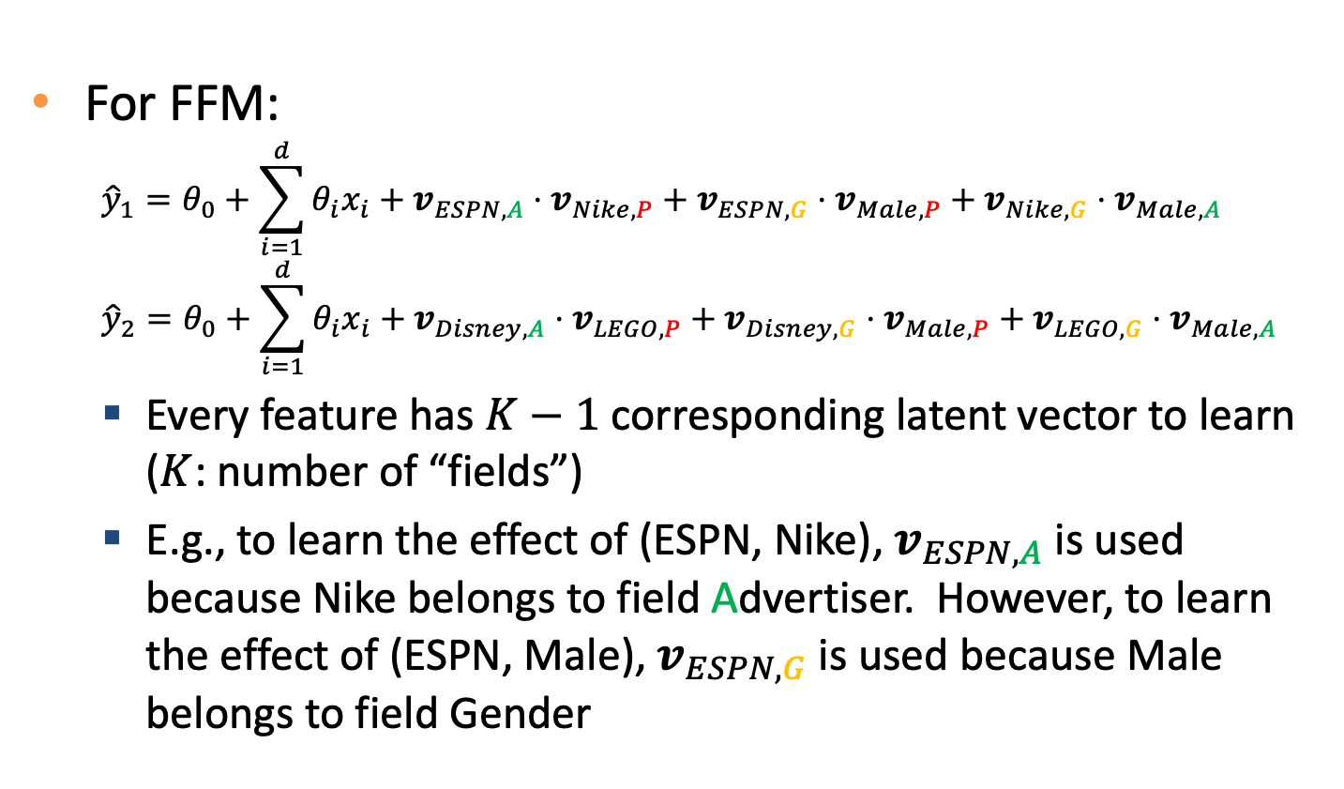
FFM example (cont’)
Publisher (P) | Advertiser (A) | Gender (G) | Clicked?
ESPN | Nike | Male | Yes
Disney | LEGO | Male | No
For FFM:
$${\hat{y}}_{1}=θ_{0}+\sum_{i=1}^{d}{θ_{i}x_{i}}+v_{ESPN,A}⋅v_{Nike,P}+v_{ESPN,G}⋅v_{Male,P}+v_{Nike,G}⋅v_{Male,A}$$
$${\hat{y}}_{2}=θ_{0}+\sum_{i=1}^{d}{θ_{i}x_{i}}+v_{Disney,A}⋅v_{LEGO,P}+v_{Disney,G}⋅v_{Male,P}+v_{LEGO,G}⋅v_{Male,A}$$
Every feature has $K−1$ corresponding latent vector to learn ($K$: number of “fields”)
E.g., to learn the effect of (ESPN, Nike), $v_{ESPN,A}$ is used because Nike belongs to field Advertiser. However, to learn the effect of (ESPN, Male), $v_{ESPN,G}$ is used because Male belongs to field Gender

Slide 13
Summary
FM as an extension of linear model
FM as a variation of poly2 model
FFM as an extension of FM
FM and FFM are especially useful when
Features are large and sparse, and
Feature pairs are important features
E.g., advertisement click prediction

Slide 14
Quiz
If we know that targets are influenced by each feature and each pair of features
Linear regression + original features can make good predictions (true or false)
Linear SVM + original features can make good predictions (true or false)
Polynomial kernel is helpful (true or false)
Linear regression + poly2 feature engineering is helpful (true or false)
Linear SVM + poly2 feature engineering is helpful (true or false)
Factorization machine is helpful (true or false)

